Slide 1
High robustness quantum random walk search algorithm with qudit Householder traversing coin
P. Danev H. Tonchev
28/07/2022

Slide 2
Contents
Introduction
Discrete time quantum random walk search
An example
Robustness of QRWS with modified coin
Modification of the walk coin
Improvement of algorithm’s stability
Robustness of QRWS with Qudit Coin
Qubits vs Qudits
QRWS with Qudit coin
Measuring the stability of the algorithm
Robustness analysis including both coin parameters
Relative stability of QRWS algorithm
Conclusion
ECAMP14

Slide 3
Introduction

Slide 4
Discrete time quantum random walk search
Discrete time quantum random walk search algorithm (DTQRWS)
Uses quantum walk to find searched element in unordered database;
Quadratically faster than the corresponding classical search algorithms.
Quantum random walk algorithm is large category of quantum algorithms. It is used in variety of quantum information topics:
quantum simulations;
quantum algorithms;
quantum cryptography.
DTQRWS | Grover search algorithm
Search in arbitrary topology | Search only in linear database
Needs more qubits | Needs less qubits
Double Oracle calls | Less Oracle calls

Slide 5
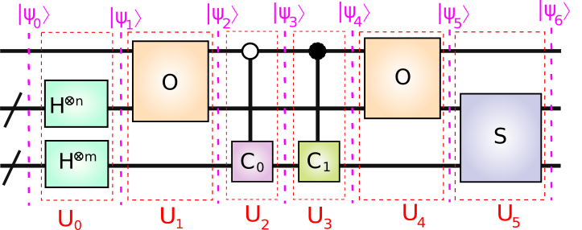
Quantum Circuit Components
$\left|ψ_{k}\right\rangle =\left|{con}_{k}, x_{k},c_{k}\right\rangle =\left|{con}_{k}\right\rangle ⊗\left| x_{k}\right\rangle$ $⊗\left|c_{k}\right\rangle$
Dim[$\left|{con}_{k}\right\rangle ]$ = 2
Dim[$\left|x_{k}\right\rangle ]$ = 2^m
Dim[$\left|c_{k}\right\rangle ]$ = m
$$\left|ψ_{k+1}\right\rangle =U_{k}\left|ψ_{k}\right\rangle \underset{→}{\text{yields}} \left|ψ_{6}\right\rangle =U_{5}U_{4}U_{3}U_{2}U_{1}U_{0}\left|ψ_{0}\right\rangle$$
Initial State:
$$\left|ψ_{0}\right\rangle =\left|0,0,0\right\rangle$$
$$U_{0}=\left\{\begin{aligned}{\hat{I}}_{2} ⊗H^{⊗n} ⊗ H^{⊗m} \\ {\hat{I}}_{2} ⊗F_{2^m} ⊗F_{m}\end{aligned}\begin{matrix} \\ \end{matrix}\begin{matrix}works on when coin is power of 2 \\ works with arbitrary coin size\end{matrix}\right.$$

Slide 6
1) Applying Hadamard Gates:
$$\left|ψ_{0}\right\rangle =\left|0,0,0\right\rangle$$
$$w=e^{−2πi/m}$$
$$F=\frac{1}{\sqrt{m}}\left(\begin{matrix}w^{0∗0} & w^{0∗1} & ⋯ & w^{0∗(m−1)} \\ w^{1∗0} & w^{1∗1} & ⋯ & w^{1∗(m−1)} \\ ⋮ & ⋮ & ⋱ & ⋮ \\ w^{(m−1)∗0} & w^{(m−1)∗1} & ⋯ & w^{(m−1)∗(m−1)}\end{matrix}\right)$$
H$=\frac{1}{\sqrt{2}}\left(\begin{matrix}1 & 1 \\ 1 & −1\end{matrix}\right)$
$${\hat{I}}_{2} =\left(\begin{matrix}1 & 0 \\ 0 & 1\end{matrix}\right)$$
$$\left|ψ_{1}\right\rangle =U_{0}\left|ψ_{0}\right\rangle$$
$\left|ψ_{1}\right\rangle =\left|0,\frac{1}{\sqrt{2^{m}}}\sum_{j=0}^{2^{m}−1}{\left|j\right\rangle },\frac{1}{\sqrt{m}}\sum_{j=0}^{m−1}{\left|j\right\rangle }\right\rangle =\frac{1}{\sqrt{d}}\left|0\right\rangle ⊗$ $\sum_{j=0}^{{m2}^{m}−1}{\left|j\right\rangle }$
2) Applying First Oracle
The Oracle marks all solutions, if solutions are $\{h_{1},..,h_{λ}\}$:
$\hat{O}=$ ${\hat{I}}_{2^{m+1}}−\sum_{i=1}^{λ}{\left(\left|h_{i}\right\rangle \left\langle h_{i}\right|+\left|h_{i}+2^{m}\right\rangle \left\langle h_{i}+2^{m}\right|\right)}$
$$+\sum_{i=1}^{λ}{\left(\left|h_{i}+2^{m}\right\rangle \left\langle h_{i}\right|+\left|h_{i}\right\rangle \left\langle h_{i}+2^{m}\right|\right)}$$

Slide 7
$\left|ψ_{1}\right\rangle =\frac{1}{\sqrt{d}}\left(0,1\right)⊗$ $\sum_{j=0}^{{m2}^{m}−1}{\left|j\right\rangle }$
$$U_{1}=\hat{O}⊗{\hat{I}}_{m}$$
$$\left|ψ_{2}\right\rangle =U_{1}\left|ψ_{1}\right\rangle$$
$\left|ψ_{2}\right\rangle =\frac{1}{\sqrt{{m2}^{m}}}\left(\left(0,1\right)⊗ \left(\sum_{j=0}^{d∗2^d−1}{\left|j\right\rangle }−\sum_{i=1}^{λ}{\left|h_{i}\right\rangle }\right)\text{+ }\left(1,0\right)⊗ \left(\sum_{i=1}^{λ}{\left|h_{i}\right\rangle }\right)\right)$ $⊗$ $\left(\sum_{j=0}^{m−1}{\left|j\right\rangle }\right)$
3) Applying Traversing Coin
$$U_{2} =\left(\begin{matrix}{\hat{I}}_{{m2}^{m}} & {\hat{0}}_{{m2}^{m}} \\ {\hat{0}}_{{m2}^{m}} & {\hat{I}}_{2^{m}}⊗C_{0}\end{matrix}\right)$$
$$\left|ψ_{3}\right\rangle =U_{2}\left|ψ_{2}\right\rangle$$
$$\left|χ\right\rangle =\frac{1}{\sqrt{N}}\sum_{j=0}^{N−1}{\left|j\right\rangle }$$
$$C_{0}\left(φ,χ,ζ\right)=e^{iζ}\left(I−(1−e^{iφ})\left|χ\right\rangle \left\langle χ\right|\right)$$
$$ζ=−2 φ+3π+α sin(2φ)$$
4) Applying Marking Coin
$$\left|ψ_{3}\right\rangle =U_{2}\left|ψ_{2}\right\rangle$$
$$U_{3} =\left(\begin{matrix}{\hat{I}}_{2^{m}}⊗C_{1} & {\hat{0}}_{{m2}^{m}} \\ {\hat{0}}_{{m2}^{m}} & {\hat{I}}_{{m2}^{m}}\end{matrix}\right)$$
$$C_{1} =−{\hat{I}}_{2}$$

Slide 8
5) Applying Second Oracle
$$U_{4}=U_{1}$$
$$\left|ψ_{5}\right\rangle =U_{4}\left|ψ_{4}\right\rangle$$
6) Applying Shift Operator
$$S=\sum_{d=0}^{m−1}{\sum_{x=0}^{2^{m}−1}{\left|x^{d},d〉\right.}}〈\left.x,d\right|$$
Where $x^{d}$ is the vector $x^{}$ with $d$^{th} bit flipped
$$U_{5}={\hat{I}}_{2}⊗S$$
$$\left|ψ_{6}\right\rangle =U_{5}\left|ψ_{5}\right\rangle$$

Slide 9
7) Measurement of the node register
$$ρ_{ψ_{k}}=\left|ψ_{k}\right\rangle 〈\left.ψ_{k}\right|=\left|{con}_{k}, x_{k},c_{k}\right\rangle 〈\left.{con}_{k}, x_{k},c_{k}\right|$$
If $ρ_{ψ_{k}}$ is separatable:
$$ρ_{ψ_{k}}=\left|{con}_{k}, x_{k},c_{k}\right\rangle 〈\left.{con}_{k}, x_{k},c_{k}\right|$$
$=\left|{con}_{k} \right\rangle 〈\left.{con}_{k}\right|⊗\left|x_{k} \right\rangle 〈\left.x_{k}\right|⊗\left|c_{k}\right\rangle 〈\left.c_{k}\right|$=$ρ_{{con}_{k}}⊗ρ_{x_{k}}⊗ρ_{c_{k}}$
$${{Tr}_{ρ_{{con}_{k}}} Tr}_{ρ_{c_{k}}} \text{[}ρ_{ψ_{k}}]=\sum_{i}{〈\left.i\right|ρ_{{con}_{k}}\left|i\right\rangle ⊗ρ_{x_{k}}⊗}\sum_{j}{〈\left.j\right|ρ_{c_{k}}\left|j\right\rangle }=ρ_{x_{k}}$$
When $ρ_{ψ_{k}}$ is not separatable:
$${Tr}_{ρ_{{con}_{k}}}\left[ρ_{ψ_{k}}\right]=\sum_{j}{\left({〈\left.j\right|}_{ρ_{{con}_{k}}}⊗{\hat{I}}_{ρ_{x_{k}}⊗ρ_{c_{k}}}\right)}ρ_{ψ_{k}}\left({\left|j\right\rangle }_{ρ_{{con}_{k}}}{⊗\hat{I}}_{ρ_{x_{k}}⊗ρ_{c_{k}}}\right)$$
$$\left[ρ_{x_{k}} \right]={Tr}_{ρ_{c_{k}}}\left[{Tr}_{ρ_{{con}_{k}}}\left[ρ_{ψ_{k}}\right]\right]=\sum_{j}{\left({\hat{I}}_{ρ_{x_{k}}}⊗{〈\left.j\right|}_{ρ_{c_{k}}}\right)}{Tr}_{ρ_{{con}_{k}}}\left[ρ_{ψ_{k}}\right]\left({\hat{I}}_{ρ_{x_{k}}}⊗{\left|j\right\rangle }_{ρ_{c_{k}}}\right)$$
M$\left[ρ_{x_{k}} \right]$ - измерване на регистъра на върховете

Slide 10
Example
Example For Coin Size 2, solutions {2}, for walk coin is used Hadamard gate and for marking coin is used -I
H$=\frac{1}{\sqrt{2}}\left(\begin{matrix}1 & 1 \\ 1 & −1\end{matrix}\right)$
${\hat{I}}_{2}$ $=\left(\begin{matrix}1 & 0 \\ 0 & 1\end{matrix}\right)$
$$\left|ψ_{0}\right\rangle ={\left(1,0,0,0,0,0,0,0,0,0,0,0,0,0,0,0\right)}^{T}$$
O=$\left(\begin{matrix}1 & 0 & 0 & 0 & 0 & 0 & 0 & 0 \\ 0 & 0 & 0 & 0 & 0 & 1 & 0 & 0 \\ 0 & 0 & 1 & 0 & 0 & 0 & 0 & 0 \\ 0 & 0 & 0 & 1 & 0 & 0 & 0 & 0 \\ 0 & 0 & 0 & 0 & 1 & 0 & 0 & 0 \\ 0 & 1 & 0 & 0 & 0 & 0 & 0 & 0 \\ 0 & 0 & 0 & 0 & 0 & 0 & 1 & 0 \\ 0 & 0 & 0 & 0 & 0 & 0 & 0 & 1\end{matrix}\right)$
$U_{0}={\hat{I}}_{2}⊗(H⊗H)⊗$ $H$
$$\left|ψ_{1}\right\rangle ={1/\sqrt{8}\left(1,1,1,1,1,1,1,1, 0,0,0,0,0,0,0,0\right)}^{T}$$
$$U_{1}=O⊗{\hat{I}}_{2}$$
$$\left|ψ_{2}\right\rangle ={1/\sqrt{8}\left(1,1,0,01,1,1,1,0,0,1,1,0,0,0,0\right)}^{T}$$
$U_{2}=$Diag[${\hat{I}}_{8}$, ${\hat{I}}_{4}⊗C_{0}$]
$${\hat{I}}_{4} =\left(\begin{matrix}1 & 0 & 0 & 0 \\ 0 & 1 & 0 & 0 \\ 0 & 0 & 1 & 0 \\ 0 & 0 & 0 & 1\end{matrix}\right)$$
$$\left|ψ_{3}\right\rangle ={\left(\frac{1}{2},0,0,0,\frac{1}{2},0,\frac{1}{2},0,0,0,\frac{1}{\sqrt{8}},\frac{1}{\sqrt{8}},0,0,0,0\right)}^{T}$$

Slide 11
$$\left|ψ_{3}\right\rangle ={\left(\frac{1}{2},0,0,0,\frac{1}{2},0,\frac{1}{2},0,0,0,\frac{1}{\sqrt{8}},\frac{1}{\sqrt{8}},0,0,0,0\right)}^{T}$$
$U_{3}=$Diag[${\hat{I}}_{4}⊗C_{1}, {\hat{I}}_{8}$]
$$\left|ψ_{4}\right\rangle ={\left(\frac{1}{2},0,0,0,\frac{1}{2},0,\frac{1}{2},0,0,0,\frac{−1}{\sqrt{8}},\frac{−1}{\sqrt{8}},0,0,0,0\right)}^{T}$$
$C_{1}$ $=−\left(\begin{matrix}1 & 0 \\ 0 & 1\end{matrix}\right)$
$$U_{4}=O⊗{\hat{I}}_{2}$$
$$\left|ψ_{5}\right\rangle ={\left(\frac{1}{2},0,\frac{−1}{\sqrt{8}},\frac{−1}{\sqrt{8}},\frac{1}{2},0,\frac{1}{2},0,0,0,0,0,0,0,0,0\right)}^{T}$$
S=$\left(\begin{matrix}0 & 0 & 0 & 0 & 1 & 0 & 0 & 0 \\ 0 & 0 & 0 & 1 & 0 & 0 & 0 & 0 \\ 0 & 0 & 0 & 0 & 0 & 0 & 1 & 0 \\ 0 & 1 & 0 & 0 & 0 & 0 & 0 & 0 \\ 1 & 0 & 0 & 0 & 0 & 0 & 0 & 0 \\ 0 & 0 & 0 & 0 & 0 & 0 & 0 & 1 \\ 0 & 0 & 1 & 0 & 0 & 0 & 0 & 0 \\ 0 & 0 & 0 & 0 & 0 & 1 & 0 & 0\end{matrix}\right)$
$$U_{5}={\hat{I}}_{2}⊗S$$
$$\left|ψ_{6}\right\rangle ={\left(\frac{1}{2},\frac{−1}{\sqrt{8}},\frac{1}{2},0,\frac{1}{2},0,\frac{−1}{\sqrt{8}},0,0,0,0,0,0,0,0,0\right)}^{T}$$
M$\left[\left|ψ_{6}\right\rangle \right]=\left(\frac{3}{8},\frac{2}{8},\frac{2}{8},\frac{1}{8} \right)$

Slide 12
Robustness of QRWS with modified coin

Slide 13
Modification of the walk coin
We study the following walk coin:
$$C_{0}\left(φ,χ,ζ\right)=\underset{Phase gate}{\underbrace{e^{iζ}}}×\underset{Generalized Householder reflection}{\underbrace{\left(I−(1−e^{iφ})\left|χ\right\rangle \left\langle χ\right|\right)}}$$
Both Generalized Householder reflection and phase gate can be done efficiently in some physical Quantum circuit implementations like the ion traps.
To have equal probability to go at each direction $χ$must be equal weight superposition of the basis vectors |j⟩
$$\left|χ\right\rangle =\frac{1}{\sqrt{m_{n}}}\sum_{j=0}^{m_{n}−1}{\left|j\right\rangle }$$
The probability to find solution $p=$ $p(ζ,φ,n)$ depends on $ζ$,$φ$ and coin register size n.

Slide 14
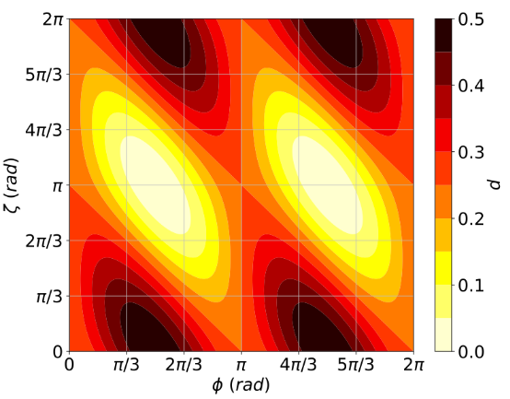
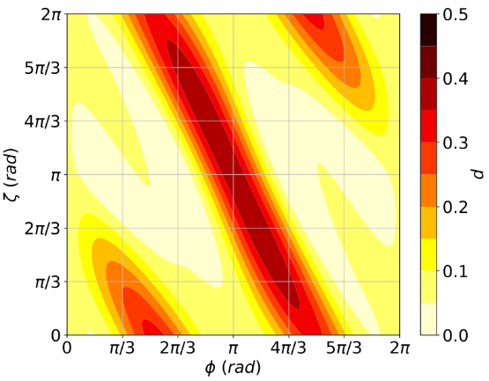
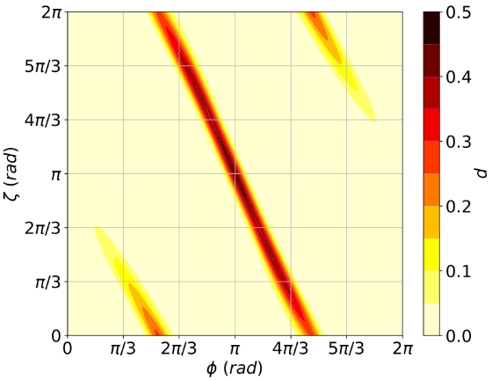
Monte Carlo simulations of the algorithm
MC simulations of p($ζ,φ$) of QRWS for Hypercube
In each run n is fixed and for $ζ,φ∈[0, 2π)$ are taken random values
One qubit coin
Two qubit coin
Three qubit coin
There exist connected areas in $(φ,ζ)$ plane with high probability to find solution!

Slide 15
Robustness of 𝑝(ζ,𝜙)
In order to make QRWS more robust to change in the phases, we search for areas in the plane defined by $(φ,ζ)$ that give high probability to find solution when one or both of the parameters vary:
$p(φ∈\left(φ_{max}−ε,φ_{max}+ε\right))≅$ $p_{max}=p$ $\left(φ_{max}\right)$
In our case p can be expressed as function of just one of the phases:
$ζ=ζ(φ)$ $⟹p(ζ(φ),φ ,n=const)⟶p(φ)$
Different functions ζ(𝜙) were fitted to MC data points, to find the one that makes the algorithm as robust as possible
Note: For Grover coin both phases $φ$ and$ζ$are equal to $π$, and $\left|χ\right\rangle$ is equal weight superposition

Slide 16
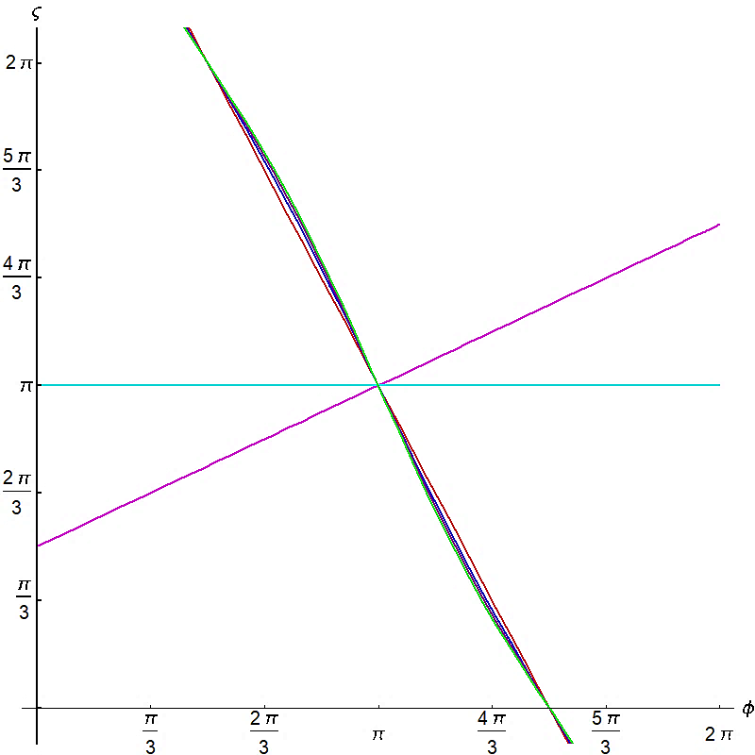
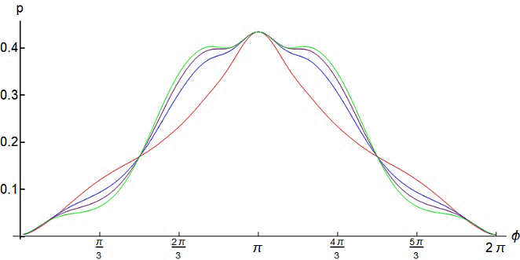
Improvement of algorithm’s stability
Examples for linear functions:
Best linear approximation:
$$ζ=−2 φ+3π$$
$ζ$=const
$$ζ=π$$
Nonlinear functions:
$$α=0.204$$
Almost linear:
$$ζ=−2 φ+3π+α sin(2φ)$$
$$α=1/(2π)$$
$$α=1/(3π)$$
Coin size $n=3$

Slide 17
Robustness of QRWS with Qudit Coin

Slide 18
Qubits vs Qudits
One qubit can be any two level quantum system:
Levels of electron in ions;
Spins of quantum dots;
Others.
Qudits can be implemented by using any system with d levels, e.g. hyperfine states of one split level due to external electric or magnetic field. All those levels should be metastable.
Qudits can be implemented with ion trap.
Qubit states $\left|ψ\right\rangle =α_{0}$ $\left|0\right\rangle$+ $α_{1}$ $\left|1\right\rangle$
$$\left|ψ\right\rangle =\sum_{j=0}^{m−1}{α_{j}\left|j\right\rangle }$$
Qubit coin register can have only power of two number of states –
2; 4; 8; 16; 32…
Often transitions between levels are made by using ancilla state.
$m=2^{k}$ k= $Integer$
$$m=Integer$$

Slide 19
Advantages of using Qudits
Using qudits instead of qubits gives various advantages for the quantum algorithms:
They are more robust against noise and give more dependable quantum computations;
The coin can have arbitrary dimension not only power of 2;
Allow us to make much more reliable extrapolations for quantum random walk search algorithm’s stability for larger coin sizes;
Increasing the size of the coin state space;
More efficient construction of various quantum gates;
New quantum error correction protocols.

Slide 20
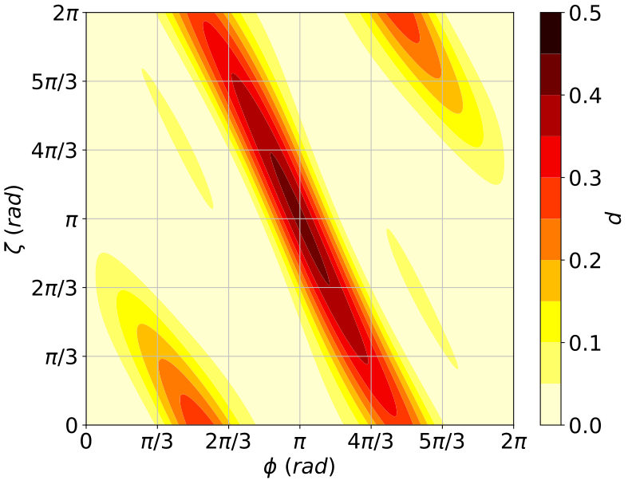
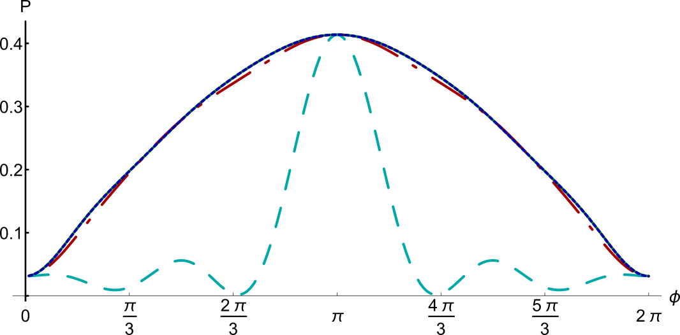
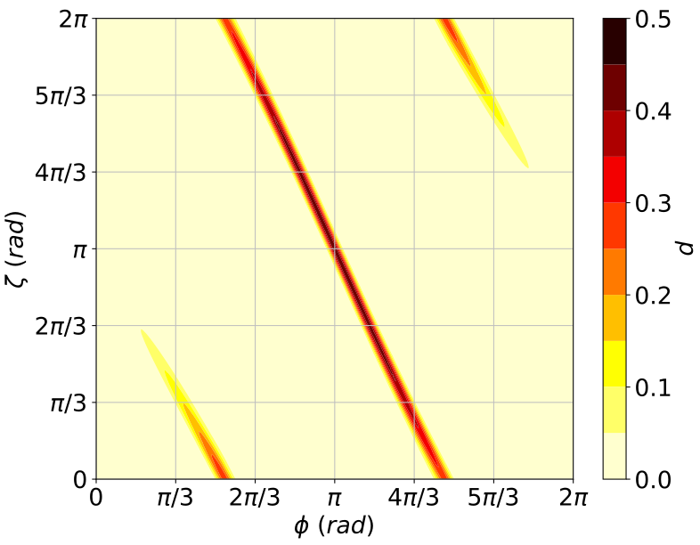
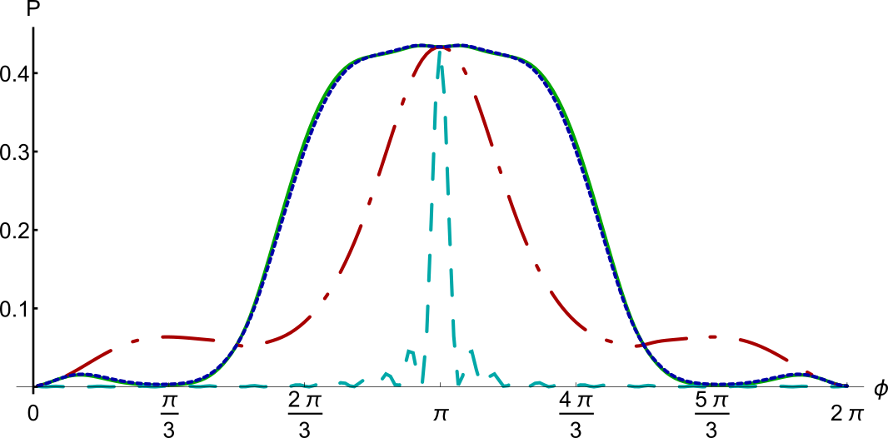
QRWS with Qudit coin
MC simulations of the algorithm with different qudit size
m=5
m=10

Slide 21
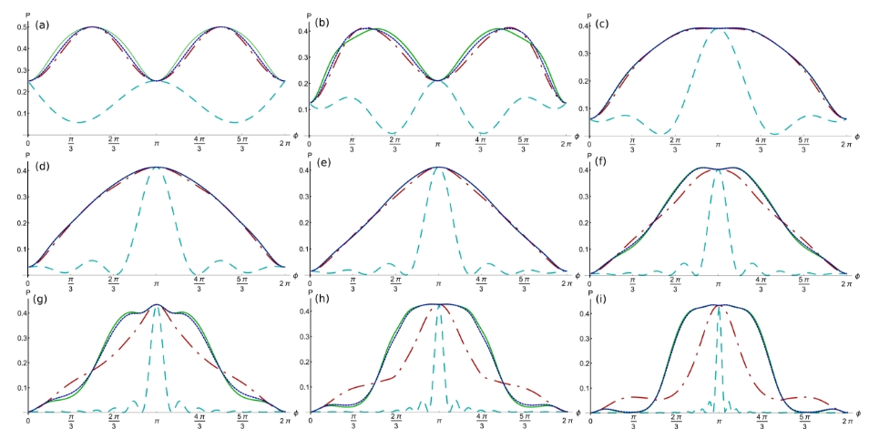
MC simulations with different qudit size
$$m=2$$
$$m=3$$
$$m=4$$
$$m=5$$
$$m=6$$
$$m=7$$
$$m=8$$
$$m=9$$
$$m=10$$
$For$ $m≥3$ central plateau area becomes more wide for higher coin size;
The optimized coins with parameter relations
$ζ=−2 φ+3π+α sin(2φ)$ give more robust algorithm.

Slide 22
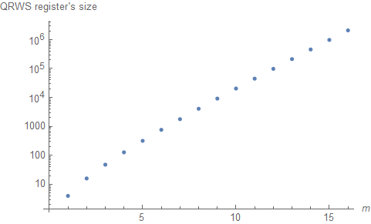
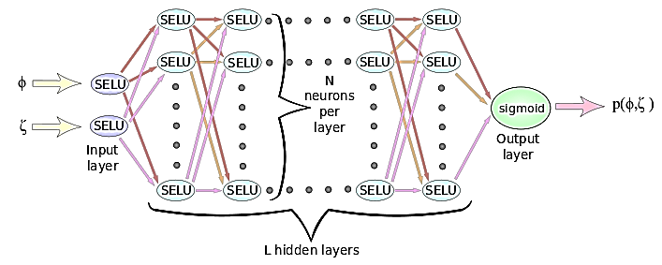
Machine learning assisted optimization
Register scaling
Dense feedforward DNN used for predictions
MC$, m=11$ ML$, m=11$ ML$, m=16$

Slide 23
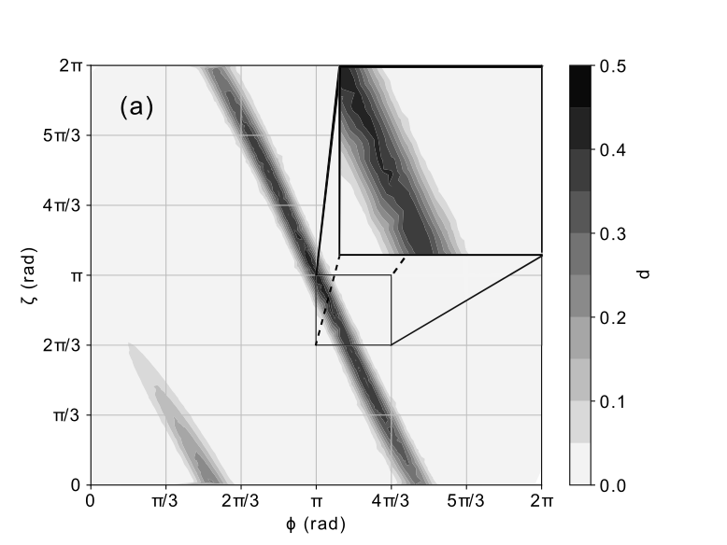
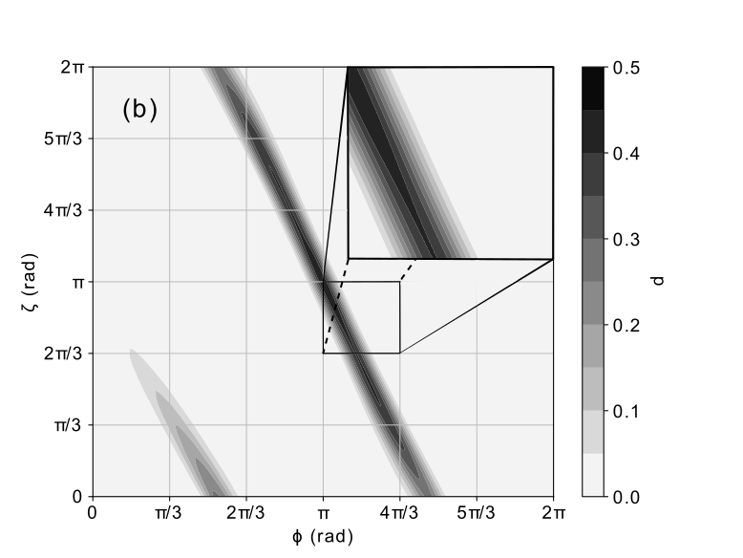
Augmenting data by machine learning
Interpolation of data within the training area
MC$, m=8$ ML$, m=8$

Slide 24
Stability interval for different ζ(𝜙)
Interval $ε$ depends on the function that is used and the acceptable probability $w·p_{max}$
$$p\left(φ∈\left(φ_{max}−ε,φ_{max}+ε\right)\right)≅w·p_{max}$$
$⟹ε=ε(m,α,w)$
Interval $ε$for different functions: found from Monte Carlo data for coin size 2-11 and by DNN – for coin size 11-16. Best value for $α=α_{ML}(m)$is found by ML. When for ζ(𝜙) is used nonlinear function, $ε$ deceases slower with increasing the coin size.
$$w=0.9$$
$$w=0.7$$
$$α=α_{ML}(m)$$
$$ζ=−2 φ+3π$$
$$ζ=−2 φ+3π+α sin(2φ)$$
$$α=1/(2π)$$
$$ζ=π$$

Slide 25
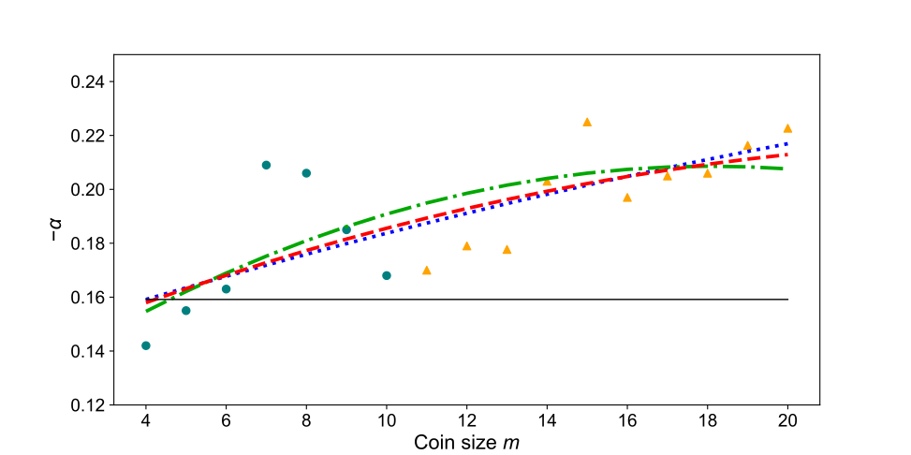
Study of the nonlinear parameter 𝛼 behavior
$ζ=−2 φ+3π+α sin\left(2φ\right)$ $− from simulations$
$− from ML$
$${α(m)=am}^{2}+bm+c$$ | $$a$$ | $$b$$ | $$c$$
$$α_{1}(m)$$ | 4.85 × 10⁻⁵ | −4.78 × 10⁻³ | −1.41 × 10⁻¹
$$α_{2}(m)$$ | 2.71 × 10⁻⁴ | −9.82 × 10⁻³ | −1.20 × 10⁻¹
$$α_{3}(m)$$ | 1.17 × 10⁻⁴ | −6.24 × 10⁻³ | −1.35 × 10⁻¹

Slide 26
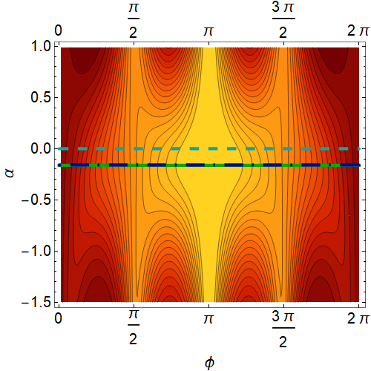
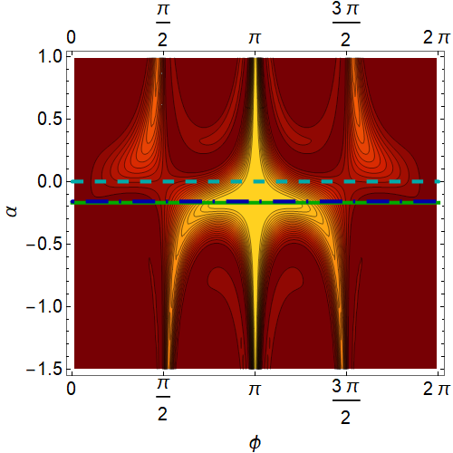
Robustness analysis including all coin parameters
Most promising results were achieved with relation:
$$ζ=−2 φ+3π+α sin\left(2φ\right)$$
$p=p\left(ζ\left(α, φ\right),φ\right)$ = $p\left(α,φ\right)$
Probability to find solution $p=p(α,φ)$ for coin size 5 and 10
$$ζ=−2 φ+3π$$
$$ζ=−2 φ+3π+α sin(2φ)$$
$$α=1/(2π)$$
$$α=α_{ML}(m)$$

Slide 27
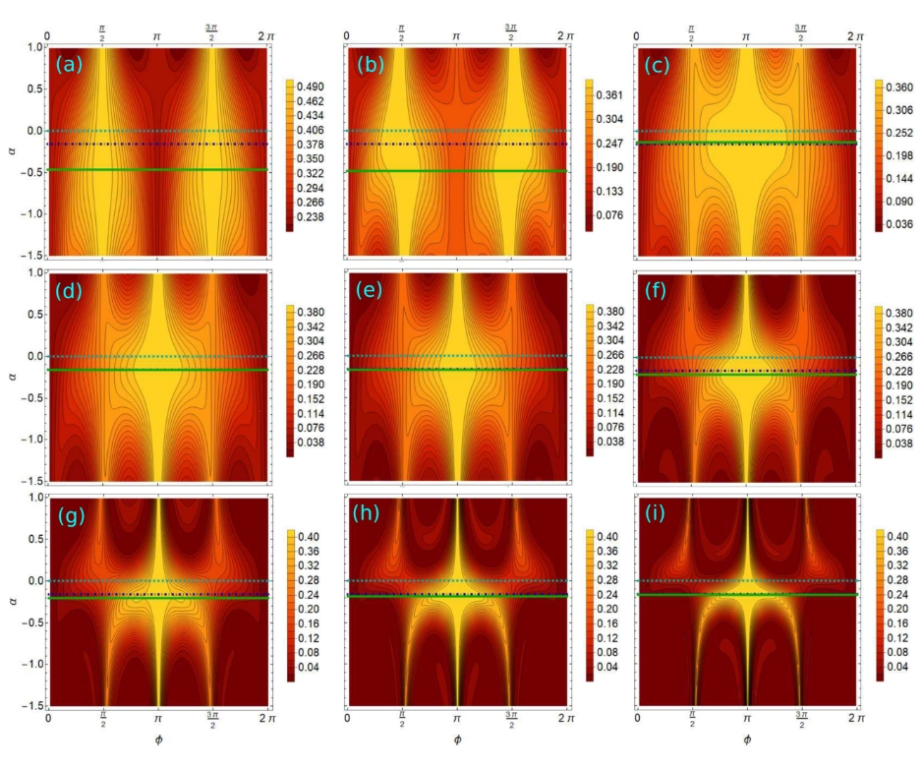
Stability area in (𝜙, 𝛼) plane
$$(2≤m ≤10)$$

Slide 28
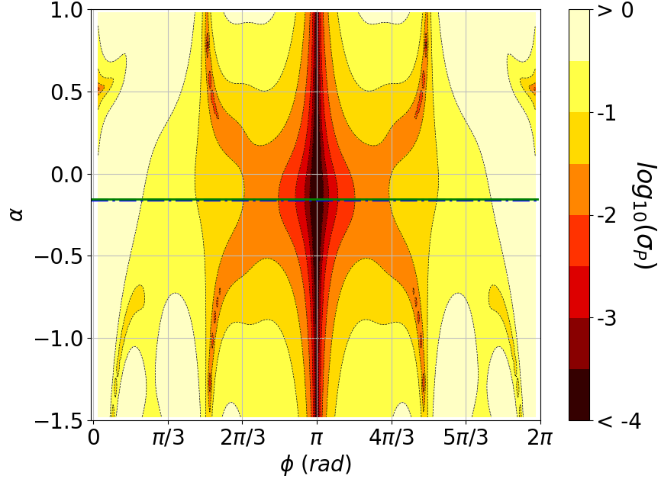
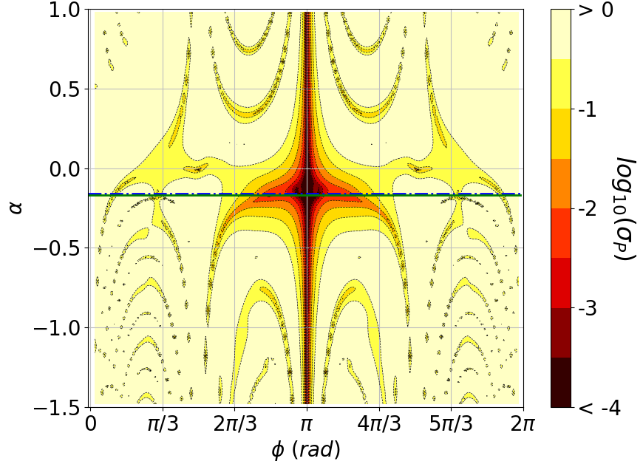
Root-mean-square deviation of p
Increased robustness of the QRWS algorithm can be evaluated by using root-mean-square deviation of the probability $p(φ,α,m)$:
$$σ_{p}^{ij}(m)=\frac{1}{p^{ij}}\sqrt{{\left(\frac{∂p^{ij}}{∂φ^{i}}\right)}^{2}σ_{φ}^{2}{\left(φ^{i}−π\right)}^{2}+{\left(\frac{∂p^{ij}}{∂α^{j}}\right)}^{2}σ_{α}^{2}{\left(α^{j}−α_{ML}(m)\right)}^{2}},σ_{φ}^{}=σ_{α}^{}=0.1$$
m=5
m=10
The large dark central area shows high stability of the QRWS algorithm near the optimal value of $α$.
The robustness against changes in the phase $φ$ is preserved

Slide 29
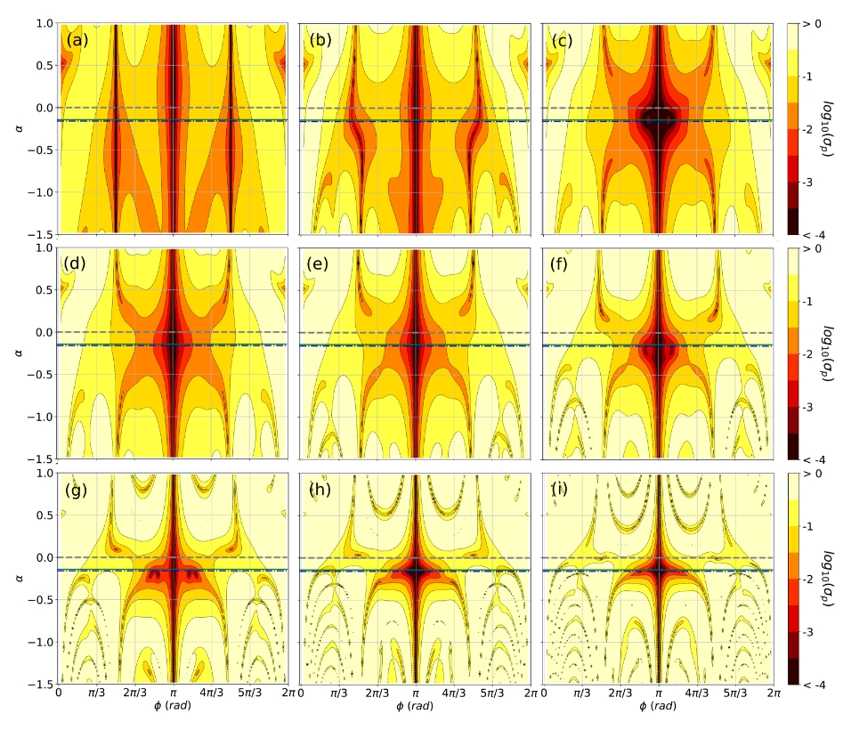
R.M.S. deviation of QRWS
$$(2≤m ≤10)$$

Slide 30
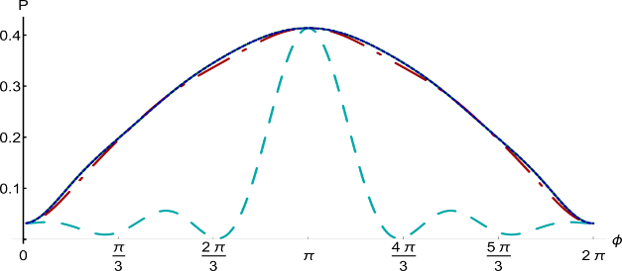
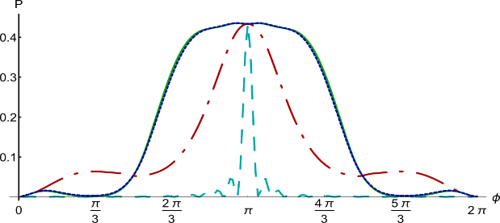
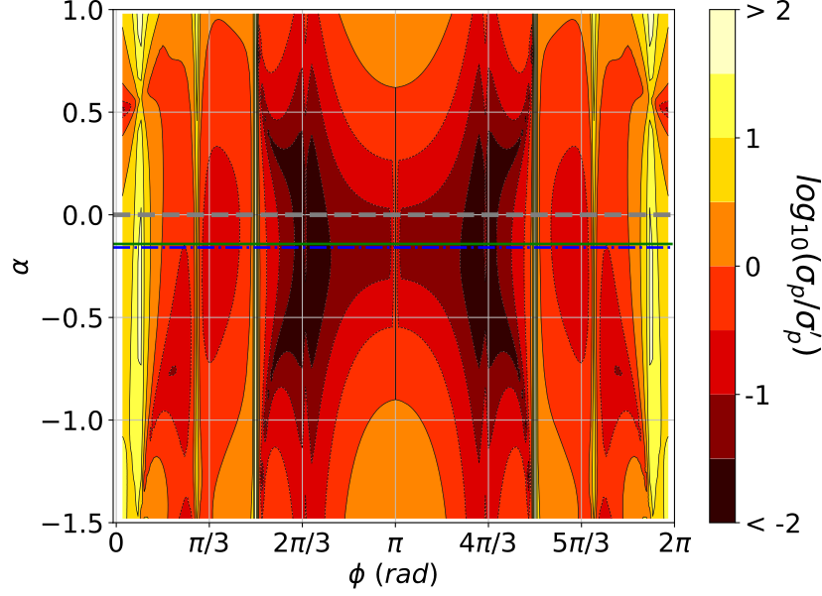
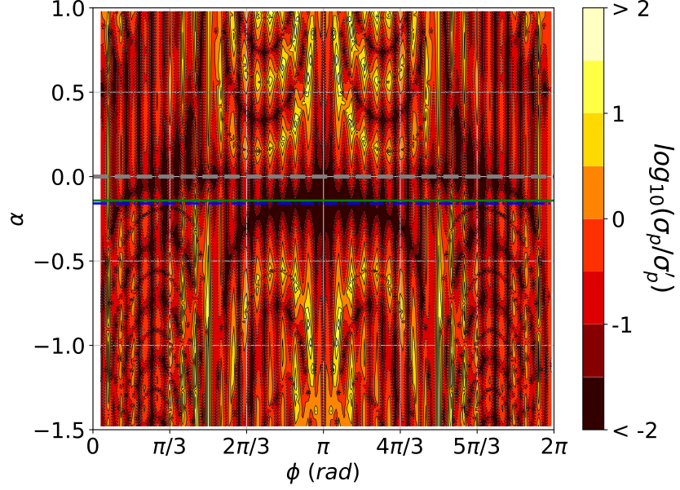
Comparison of stability between standard and optimized coin
${σ′}_{p}^{i}=\frac{1}{{p′}^{i}}\left|\frac{∂{p′}^{i}}{∂φ^{i}}σ_{φ}\left(φ^{i}−π\right)\right|$
Robustness of the QRWS algorithm in both cases, when coin is constructed by using $ζ=π$ and nonlinear function should be compared to evaluate the gain of using nonlinear function. It can be done by dividing a root-mean-square deviations of the both probabilities.
$σ_{p}^{′i}=\frac{1}{{p′}^{i}}\left|\frac{∂{p′}^{i}}{∂φ^{i}}σ_{φ}\left(φ^{i}−π\right)\right|$
m=5
m=10
CENSORED
CENSORED
CENSORED
CENSORED
High stability of nonlinear coin in central region compared to standard coin with $ζ=π$

Slide 31
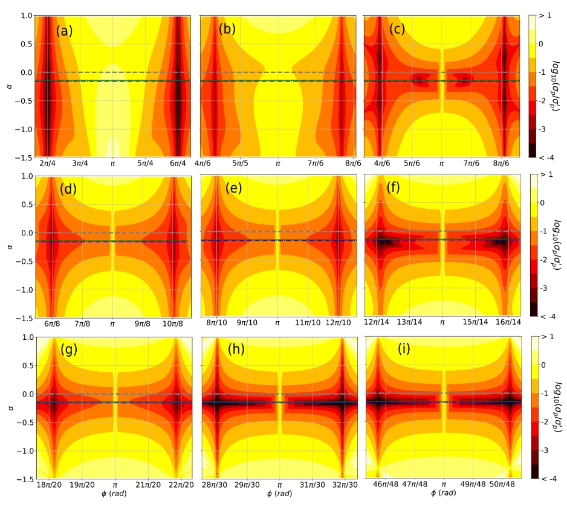
Relative robustness of QRWS $(2≤m ≤10)$
$$The relative stability of the modified algorithm$$
$$increases with increasing the coin size!$$

Slide 32
Conclusion
The discrete time quantum random walk search is quantum algorithm able to search in unordered database with arbitrary topology. It is quadratically faster than the corresponding classical search algorithms;
A modification of the algorithm with walk coin constructed by Generalized Householder reflections and a phase gate could be made extremely robust to deviations in the coin parameters if a proper relations between the parameters is maintained;
Using qudits for walk coin register give the possibility to increase even more algorithm’s stability;
Quantitative numerical analysis of quantum random walk search algorithm’s robustness to all coin parameters have been done;
With Monte Carlo and machine learning methods we made predictions for the stability of algorithm’s implementation with larger coin size.

Slide 33
ECAMP14

Slide 34
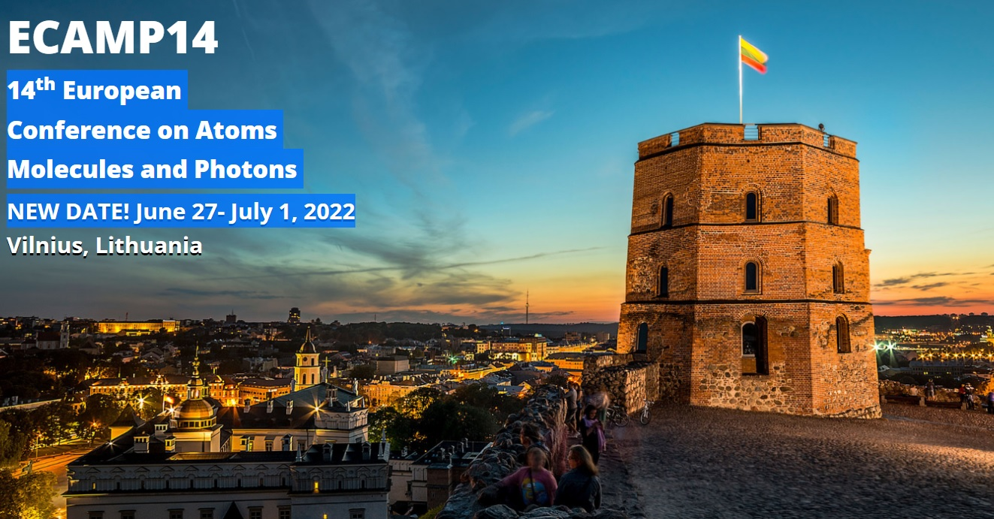
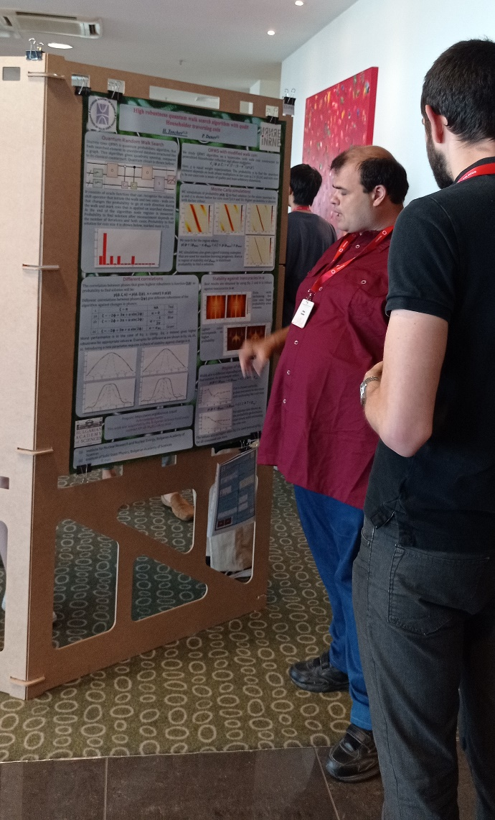
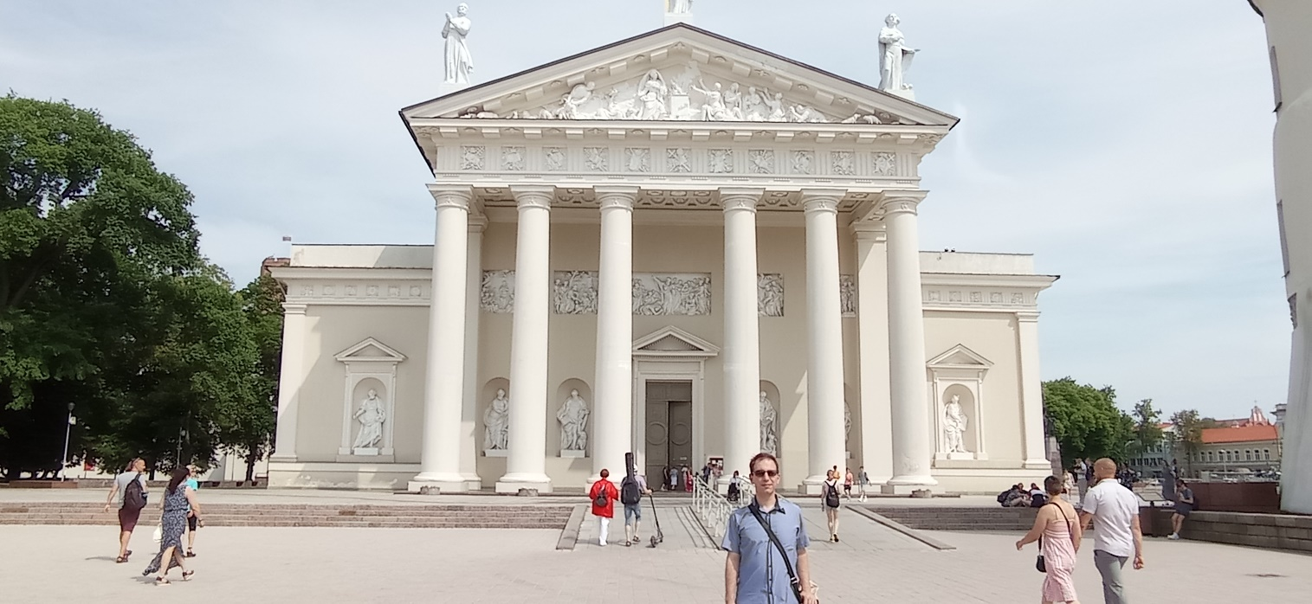

Slide 35
ECAMP14 at glance
More than:
260 participants from 20 countries
220 poster presentations
9 Plenary lectures and 50 lectures in two parallel sessions
Topics:
Atomic and Molecular spectroscopy
Quantum information and cavity QED
Fundamental physics, precision measurements and metrology
Photon induced processes
Highly charged ions
Rydberg atoms and ultra-cold plasmas and others

Slide 36
Quantum technologies for single molecular ions
Over the past years an impressive progress in the development of experimental methods which enable the control of single isolated quantum systems has been made
Molecules offer prospects as novel platforms for:
precise determinations of fundamental constants and their possible variations,
new frequency standards and clocks,
high-fidelity qubits for use in quantum information processing,
cold chemistry, etc.
(1) Molecular-ion quantum technologies, M Sinhal, S Willitsch, arXiv preprint arXiv:2204.08814

Slide 37
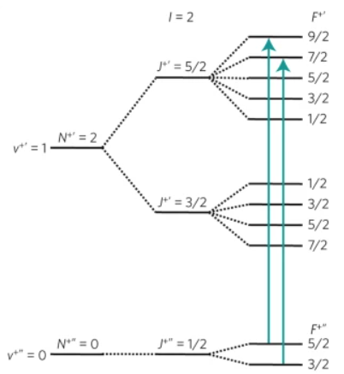
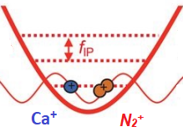
Precision spectroscopy of N₂ ⁺
Trapping of singular nitrogen molecular ion together with Ca⁺.
Ca⁺ ions are used for:
Sympathetic cooling
Nondemolition state detection (2)
Electrical quadrupole transitions in 28N₂ ⁺ (1)
(1) M. Germann, X. Tong, S. Willitsch, Observation of electric-dipole-forbidden infrared transitions in cold molecular ionsNature Physics 10 (11), 820-824 (2014)
(2) M. Sinhal, Z. Meir, K. Najafian, G. Hegi and S. Willitsch, Quantum-nondemolition state detection and spectroscopy of single trapped molecules, Science 367, 1213 (2020).

Slide 38
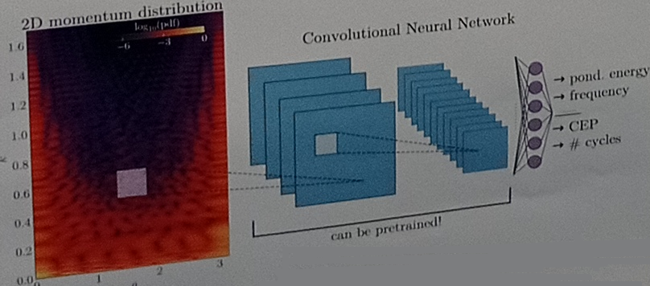
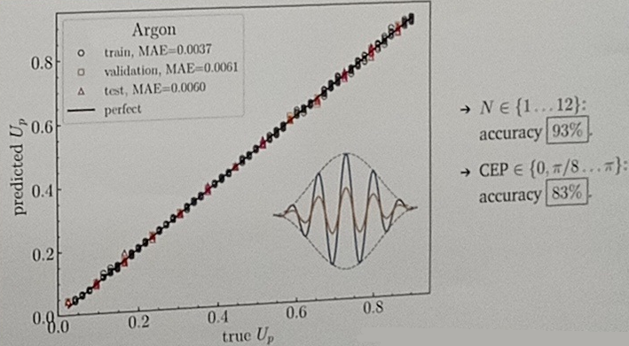
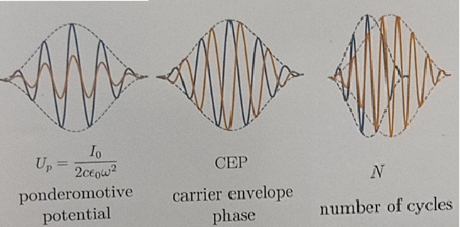
Photoelectron momentum distribution of attosecond pulses – machine learning based parameter determination
Convolutional network to determine pulse parameters from the 2D plots of the scattered electron distribution – $k,$ θ
Scattering of electrons with attosecond EM pulses
Ultrafast processes are strongly sensitive to pulse parameters wavelength,
High accuracy of CNN ( > 99% for pulse intensity)

Slide 39
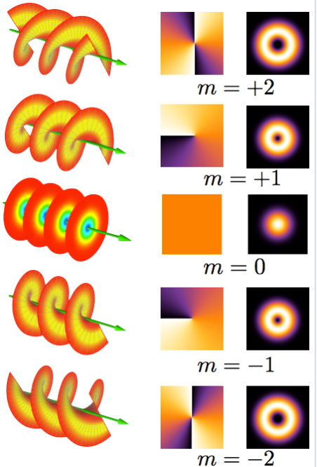
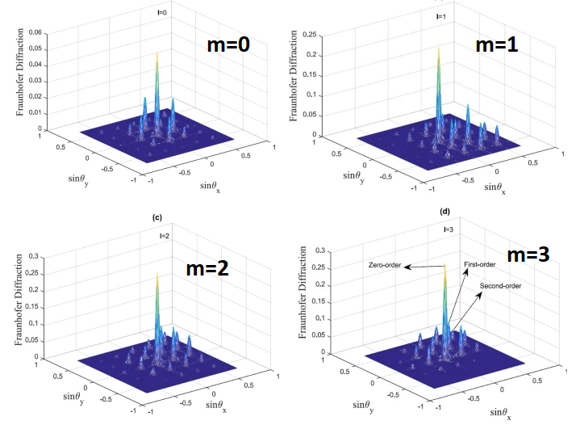
Twisted light
(Structured light, Orbital Angular Momentum of light)
Applications:
Transfer huge quantities of data through optical fibers – Terabits per second;
Use in quantum information;
Inducing high-order multipole transitions;
Angular momentum transfer,…
m – angular momentum of light,
optical vortex topological charge,
winding number
Asadpour, S.H., Kirova, T., Qian, J. et al. Azimuthal modulation of electromagnetically induced grating using structured light, Sci Rep 11, 20721 (2021).

Slide 40
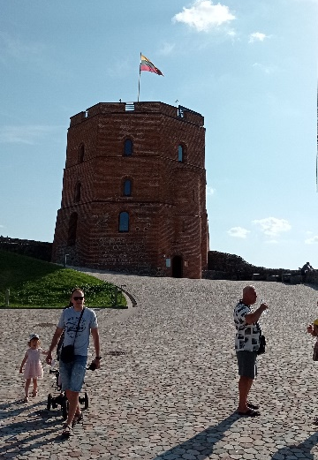
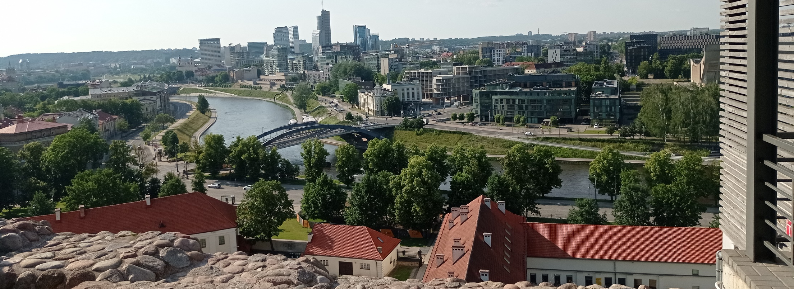
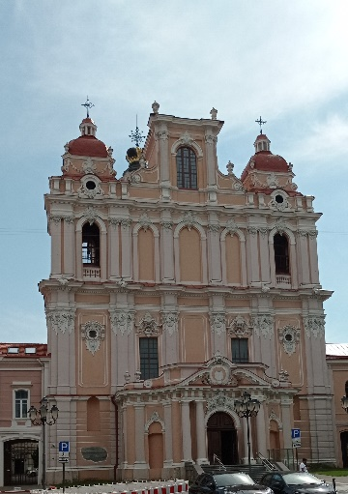
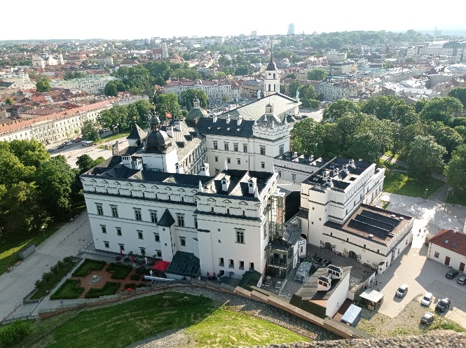
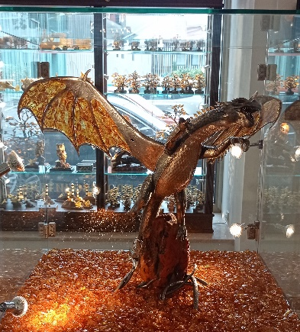
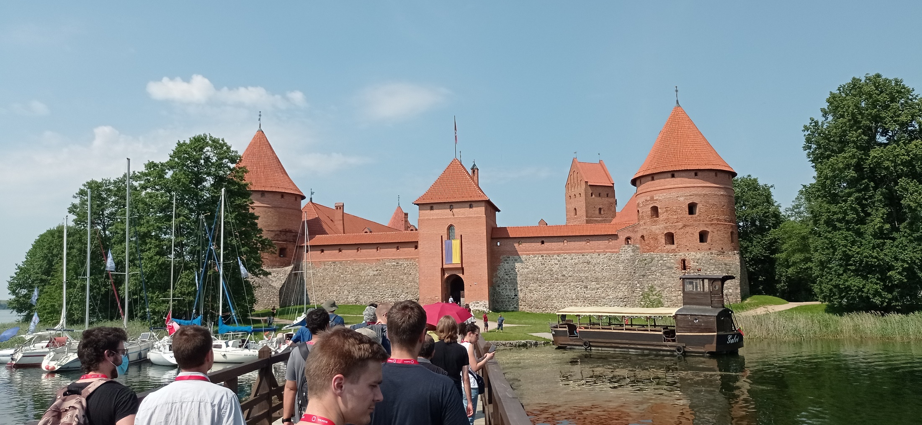
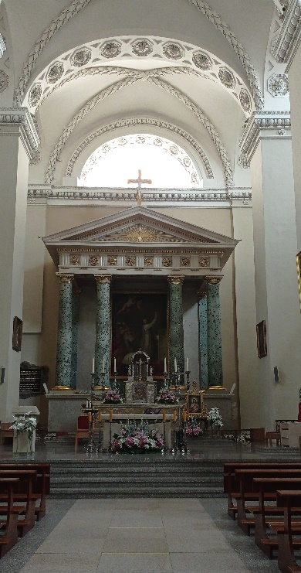
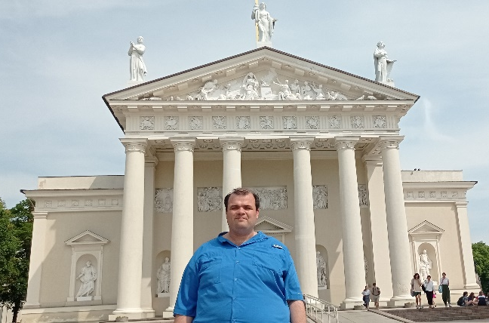
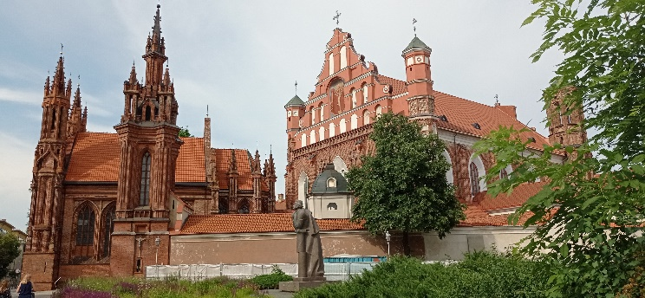

Slide 41
Thank you for your attention!
This work was supported by the Bulgarian Science Fund under contract KP-06-M48/2 /26.11.2020.

Slide 42
Example 2
Example For Coin Size 3, solutions {2,6} (or $x_{k}$=1 & $x_{k}$=5), for walk coin is used Grover Coin and for marking coin is used -I
$\left|ψ_{k}\right\rangle =\left|{con}_{k}, x_{k},c_{k}\right\rangle$= $\left|{con}_{k}\right\rangle$ $⊗\left|x_{k} \right\rangle ⊗$ $\left|c_{k}\right\rangle$
Dim[$\left|ψ_{k}\right\rangle$]=3*2^(3+1)=48
$$\left|ψ_{0}\right\rangle =\left|0, 0,0\right\rangle$$
$U_{0}={\hat{I}}_{2}⊗H^{⊗3}⊗$ $F_{3}$
$$F_{3}=\frac{1}{\sqrt{3}}\left(\begin{matrix}1 & 1 & 1 \\ 1 & e^{2iπ/3} & e^{−2iπ/3} \\ 1 & e^{−2iπ/3} & e^{2iπ/3}\end{matrix}\right)$$
${\hat{I}}_{3}$ $=\left(\begin{matrix}1 & 0 & 0 \\ 0 & 1 & 0 \\ 0 & 0 & 1\end{matrix}\right)$
$H^{⊗3}$=${\left(\frac{1}{\sqrt{2}}\right)}^{3}$ $\left(\begin{matrix}1 & 1 \\ 1 & −1\end{matrix}\right)$ $⊗\left(\begin{matrix}1 & 1 \\ 1 & −1\end{matrix}\right)⊗$ $\left(\begin{matrix}1 & 1 \\ 1 & −1\end{matrix}\right)$
${\hat{I}}_{2}$ $=\left(\begin{matrix}1 & 0 \\ 0 & 1\end{matrix}\right)$
$$\left|ψ_{1}\right\rangle =U_{0}\left|ψ_{0}\right\rangle =\frac{1}{2\sqrt{6}}\left|0\right\rangle ⊗\sum_{j_{1}=0}^{2^{3}−1}{\sum_{j_{2}=0}^{2}{\left|j_{1}\right\rangle ⊗\left|j_{2}\right\rangle }}$$
$\hat{O}=$ ${\hat{I}}_{16}−\left(\left|2\right\rangle \left\langle 2\right|+\left|10\right\rangle \left\langle 10\right|+\left|6\right\rangle \left\langle 6\right|+\left|14\right\rangle \left\langle 14\right|\right)+\left(\left|2\right\rangle \left\langle 10\right|+\left|10\right\rangle \left\langle 2\right|+\left|6\right\rangle \left\langle 14\right|+\left|14\right\rangle \left\langle 6\right|\right)$

Slide 43
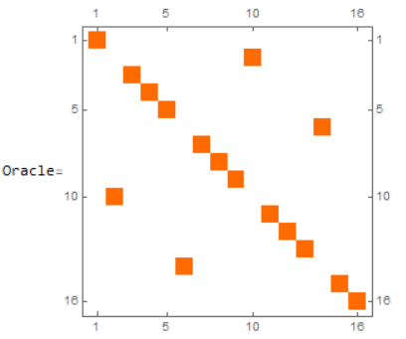
Example 2
$$U_{1}=O⊗{\hat{I}}_{3}$$
$\left|ψ_{2}\right\rangle =U_{1}\left|ψ_{1}\right\rangle =\frac{1}{2\sqrt{6}}\left|0\right\rangle ⊗\sum_{j_{1}=0}^{2^{3}−1}{\sum_{j_{2}=0}^{2}{\left|j_{1}\right\rangle ⊗\left|j_{2}\right\rangle }}$- $\frac{1}{2\sqrt{6}}\left|0\right\rangle ⊗$ ($\left|1\right\rangle +\left|5\right\rangle$) $⊗ \sum_{j_{2}=0}^{2}{\left|j_{2}\right\rangle }$) + $\frac{1}{2\sqrt{6}}\left|1\right\rangle ⊗$($\left|1\right\rangle$+ $\left|5\right\rangle$) $⊗\sum_{j_{2}=0}^{2}{\left|j_{2}\right\rangle }$
$U_{2}=$Diag[${\hat{I}}_{24}$, ${\hat{I}}_{8}⊗C_{0}$]
$$C_{0}=\frac{1}{3}\left(\begin{matrix}−1 & 2 & 2 \\ 2 & −1 & 2 \\ 2 & 2 & −1\end{matrix}\right)$$
$$\left|ψ_{3}\right\rangle =U_{2}\left|ψ_{2}\right\rangle =\left|ψ_{2}\right\rangle$$
$$C_{1}=−{\hat{I}}_{3}$$
$U_{3}=$Diag[${\hat{I}}_{8}⊗C_{1}, {\hat{I}}_{24}$]
$\left|ψ_{4}\right\rangle =U_{1}\left|ψ_{1}\right\rangle =\frac{1}{2\sqrt{6}}\left|0\right\rangle ⊗(\sum_{j_{1}=0}^{2^{3}−1}{\sum_{j_{2}=0}^{2}{\left|j_{1}\right\rangle ⊗\left|j_{2}\right\rangle }}$-($\left|1\right\rangle +\left|5\right\rangle$) $⊗$ $\sum_{j_{2}=0}^{2}{\left|j_{2}\right\rangle }$) - $\frac{1}{2\sqrt{6}}(\left|1\right\rangle ⊗\text{(}\left|1\right\rangle +\left|5\right\rangle \text{)}⊗\sum_{j_{2}=0}^{2}{\left|j_{2}\right\rangle })$

Slide 44
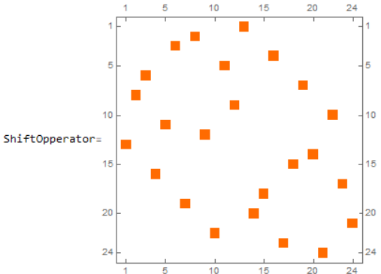
Example 2
$U_{4}=O⊗{\hat{I}}_{3}$= $U_{4}$
$$U_{5}={\hat{I}}_{2}⊗S$$
$$\left|ψ_{5}\right\rangle =U_{4}\left|ψ_{4}\right\rangle =\frac{1}{2\sqrt{6}}\left|0\right\rangle ⊗\sum_{j_{1}=0}^{2^{3}−1}{\sum_{j_{2}=0}^{2}{\left|j_{1}\right\rangle ⊗\left|j_{2}\right\rangle }}\text{−}$$
$$\frac{2}{2\sqrt{6}}\left|0\right\rangle ⊗\text{(}\left|1\right\rangle +\left|5\right\rangle \text{)}⊗\sum_{j_{2}=0}^{2}{\left|j_{2}\right\rangle }$$
$$S=\sum_{d=0}^{3−1}{\sum_{x=0}^{2^{3}−1}{\left|x^{d},d〉\right.}}〈\left.x,d\right|$$
$\left|ψ_{6}\right\rangle =U_{5}\left|ψ_{5}\right\rangle =\frac{1}{2\sqrt{6}}\left|0\right\rangle ⊗(\sum_{j_{1}=0}^{2^{3}−1}{\sum_{j_{2}=0}^{2}{\left|j_{1}\right\rangle ⊗\left|j_{2}\right\rangle }}$ - 2*($\left|0\right\rangle ⊗\left|2\right\rangle$ + $\left|1\right\rangle ⊗\left|0\right\rangle$ + $\left|3\right\rangle ⊗\left|1\right\rangle$ +$\left|4\right\rangle ⊗\left|2\right\rangle$ + $\left|5\right\rangle ⊗\left|0\right\rangle$ + $\left|7\right\rangle ⊗\left|1\right\rangle$)
M$\left[\left|ψ_{6}\right\rangle \right]=\frac{1}{2\sqrt{6}}\left(1,1,1,1,1,1,1,1\right)$

Slide 45
Example 2
$$U_{6}≡U_{1}$$
$$U_{7}≡U_{2}$$
$\left|ψ_{7}\right\rangle =U_{6}\left|ψ_{6}\right\rangle =\frac{1}{2\sqrt{6}}\left|0\right\rangle ⊗(\sum_{j_{1}=0}^{2^{3}−1}{\sum_{j_{2}=0}^{2}{\left|j_{1}\right\rangle ⊗\left|j_{2}\right\rangle }}$ - $\frac{1}{2\sqrt{6}}\left|0\right\rangle ⊗$ $(\left|1\right\rangle +\left|5\right\rangle )⊗\sum_{j_{2}=0}^{2}{\left|j_{2}\right\rangle }$+$\frac{1}{2\sqrt{6}}\left|1\right\rangle ⊗$ $(\left|1\right\rangle +\left|5\right\rangle )⊗\sum_{j_{2}=1}^{2}{\left|j_{2}\right\rangle \text{−}\frac{1}{2\sqrt{6}}\left|1\right\rangle }$ $⊗$ $(\left|1\right\rangle +\left|5\right\rangle )⊗$ $\left|0\right\rangle$
$\left|ψ_{8}\right\rangle =U_{7}\left|ψ_{7}\right\rangle =\frac{1}{2\sqrt{6}}\left|0\right\rangle ⊗\left(\left|2\right\rangle +\left|6\right\rangle \right)⊗\sum_{j_{2}=0}^{2}{\left|j_{2}\right\rangle }+\frac{−1}{12\sqrt{6}}\left|0\right\rangle ⊗\left(\left|0\right\rangle ⊗\left|0\right\rangle +\left|0\right\rangle ⊗\left|1\right\rangle +\left|3\right\rangle ⊗\left|0\right\rangle +\left|3\right\rangle ⊗\left|2\right\rangle +\left|4\right\rangle ⊗\left|0\right\rangle +\left|4\right\rangle ⊗\left|1\right\rangle +\left|7\right\rangle ⊗\left|0\right\rangle +\left|7\right\rangle ⊗\left|2\right\rangle \right)+$ $\frac{10}{12\sqrt{6}}\left|0\right\rangle ⊗(\left|0\right\rangle ⊗\left|2\right\rangle +\left|3\right\rangle ⊗\left|1\right\rangle +\left|4\right\rangle ⊗\left|2\right\rangle +\left|7\right\rangle ⊗\left|1\right\rangle$) $+ \frac{1}{2\sqrt{6}}\left|1\right\rangle ⊗$ $(\left|1\right\rangle +\left|5\right\rangle )⊗\sum_{j_{2}=1}^{2}{\left|j_{2}\right\rangle \text{−}\frac{1}{2\sqrt{6}}\left|1\right\rangle }$ $⊗$ $(\left|1\right\rangle +\left|5\right\rangle )⊗$ $\left|0\right\rangle$

Slide 46
Example 2
$$U_{8}≡U_{3}$$
$$U_{9}≡U_{4}$$
$\left|ψ_{9}\right\rangle =U_{8}\left|ψ_{8}\right\rangle =\frac{1}{2\sqrt{6}}\left|0\right\rangle ⊗\left(\left|2\right\rangle +\left|6\right\rangle \right)⊗\sum_{j_{2}=0}^{2}{\left|j_{2}\right\rangle }+\frac{−1}{12\sqrt{6}}\left|0\right\rangle ⊗\left(\left|0\right\rangle ⊗\left|0\right\rangle +\left|0\right\rangle ⊗\left|1\right\rangle +\left|3\right\rangle ⊗\left|0\right\rangle +\left|3\right\rangle ⊗\left|2\right\rangle +\left|4\right\rangle ⊗\left|0\right\rangle +\left|4\right\rangle ⊗\left|1\right\rangle +\left|7\right\rangle ⊗\left|0\right\rangle +\left|7\right\rangle ⊗\left|2\right\rangle \right)+$ $\frac{10}{12\sqrt{6}}\left|0\right\rangle ⊗(\left|0\right\rangle ⊗\left|2\right\rangle +\left|3\right\rangle ⊗\left|1\right\rangle +\left|4\right\rangle ⊗\left|2\right\rangle +\left|7\right\rangle ⊗\left|1\right\rangle$) $−\frac{1}{2\sqrt{6}}\left|1\right\rangle ⊗$ $(\left|1\right\rangle +\left|5\right\rangle )⊗\sum_{j_{2}=1}^{2}{\left|j_{2}\right\rangle \text{+}\frac{1}{2\sqrt{6}}\left|1\right\rangle }$ $⊗$ $(\left|1\right\rangle +\left|5\right\rangle )⊗$ $\left|0\right\rangle$
$\left|ψ_{10}\right\rangle =U_{9}\left|ψ_{9}\right\rangle =\frac{1}{2\sqrt{6}}\left|0\right\rangle ⊗\left(\left|2\right\rangle +\left|6\right\rangle \right)⊗\sum_{j_{2}=0}^{2}{\left|j_{2}\right\rangle }+\frac{−1}{12\sqrt{6}}\left|0\right\rangle ⊗\left(\left|0\right\rangle ⊗\left|0\right\rangle +\left|0\right\rangle ⊗\left|1\right\rangle +\left|3\right\rangle ⊗\left|0\right\rangle +\left|3\right\rangle ⊗\left|2\right\rangle +\left|4\right\rangle ⊗\left|0\right\rangle +\left|4\right\rangle ⊗\left|1\right\rangle +\left|7\right\rangle ⊗\left|0\right\rangle +\left|7\right\rangle ⊗\left|2\right\rangle \right)+$ $\frac{10}{12\sqrt{6}}\left|0\right\rangle ⊗(\left|0\right\rangle ⊗\left|2\right\rangle +\left|3\right\rangle ⊗\left|1\right\rangle +\left|4\right\rangle ⊗\left|2\right\rangle +\left|7\right\rangle ⊗\left|1\right\rangle$) $−\frac{1}{2\sqrt{6}}\left|0\right\rangle ⊗$ $(\left|1\right\rangle +\left|5\right\rangle )⊗\sum_{j_{2}=1}^{2}{\left|j_{2}\right\rangle \text{+}\frac{1}{2\sqrt{6}}\left|0\right\rangle }$ $⊗$ $(\left|1\right\rangle +\left|5\right\rangle )⊗$ $\left|0\right\rangle$

Slide 47
Example 2
$$U_{10}≡U_{5}$$
$$\left|ψ_{10}\right\rangle =U_{9}\left|ψ_{9}\right\rangle =\frac{1}{2\sqrt{6}}\left|0\right\rangle ⊗\left(\left|0\right\rangle ⊗\left|1\right\rangle −\left|0\right\rangle ⊗\left|2\right\rangle +\left|1\right\rangle ⊗\left|0\right\rangle +\left|2\right\rangle ⊗\left|0\right\rangle −\left|3\right\rangle ⊗\left|1\right\rangle +\left|3\right\rangle ⊗\left|2\right\rangle +\left|4\right\rangle ⊗\left|1\right\rangle −\left|4\right\rangle ⊗\left|2\right\rangle +\left|5\right\rangle ⊗\left|0\right\rangle +\left|6\right\rangle ⊗\left|0\right\rangle −\left|7\right\rangle ⊗\left|1\right\rangle +\left|7\right\rangle ⊗\left|2\right\rangle \right)$$
$+\frac{−1}{12\sqrt{6}}\left|0\right\rangle ⊗\left(\left|0\right\rangle ⊗\left|0\right\rangle +\left|2\right\rangle ⊗\left|1\right\rangle +\left|2\right\rangle ⊗\left|2\right\rangle +\left|3\right\rangle ⊗\left|0\right\rangle +\left|4\right\rangle ⊗\left|0\right\rangle +\left|6\right\rangle ⊗\left|1\right\rangle +\left|6\right\rangle ⊗\left|2\right\rangle +\left|7\right\rangle ⊗\left|0\right\rangle \right)+$ $\frac{10}{12\sqrt{6}}\left|0\right\rangle ⊗(\left|1\right\rangle ⊗\left|1\right\rangle +\left|1\right\rangle ⊗\left|2\right\rangle +\left|5\right\rangle ⊗\left|1\right\rangle +\left|5\right\rangle ⊗\left|2\right\rangle )$
M$\left[\left|ψ_{10}\right\rangle \right]=\left(0.0879,0.2731,0.0509,0.0879,0.0879,0.2731,0.0509,0.0879\right)$

Slide 48
Shift Operator
Shift operator S defines the topology of the walked object
Coin Register Size is 2
Coin Register Size is 3
Coin Register Size is 4

Slide 49
Hypercube and Node Numbering
Hypercubes with different dimensions (0 - 3):
Number of nodes and edges of such Hypercube are: $E_{0,d}^{}=2^{d}$ $E_{1,d}^{}=R2^{d−1}$
Each node (and also edges) can be numbered with binary string label. Zeroth node can be arbitrary chosen.
Two nodes in a hypercube are neighbors, if they differ by only one symbol (their Hamming distance is 1).

Slide 50
Walk Coin
Walk coin gives probabilities for transition between nodes connected by an edge.
The system can be in superposition of nodes, so during the evolution it can go to different superposition of states.
If probability to go in each direction is the same, then off diagonal matrix elements should be the same.
Original QRWS algorithm uses Grover coin G for traversing a graph. For coin with size n:
$$G=\left(\begin{matrix}−1+2/n & 2/n & … & 2/n \\ 2/n & −1+2/n & … & 2/n \\ ⋮ & ⋮ & ⋱ & ⋮ \\ 2/n & 2/n & … & −1+2/n\end{matrix}\right)$$

Slide 51
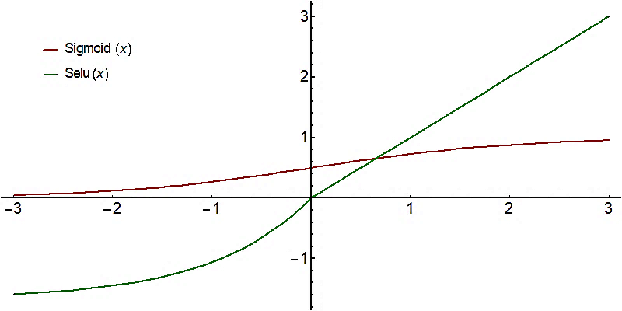
Machine learning and optimization
This neural network is used to fit training examples to obtain a ML model that best approximate quantum random walk search algorithm. This model is used to optimize the quantum algorithm
Feed Forward NN – network were information flows from k-th to (k+1)-th layer. No information flows between neurons on the same layer or from (k+1)-th layer to the k-th.
Activation Function of neuron – non-linear function, witch result depends on the input
$SELU\left(x\right)=\left\{\begin{matrix}x & if x>0 \\ \text{1.673}\left(e^{x}−1\right) & if x≤0\end{matrix}\right.$
$$Sigmoid\left(x\right)=\frac{1}{1+e^{−x}}$$
Gradient descent is an iterative optimization algorithm for finding a local minimum of a function by making steps at direction of the steepest descent.

Slide 52
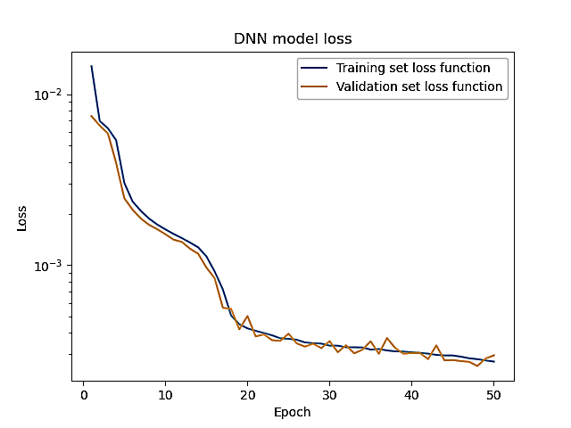
Epoch – one run of the neuron network trough training examples. Network update its parameters at end of each epoch.
Batch Gradient Descent – At each epoch, lost function is calculated by smaller portion of training examples (batch). This batch is taken by random training examples. Therefore there is larger uncertainty at the end of the training, lost function oscillate around the minimum.
Training Set – set used to train NN
Validation Set – set used to evaluate NN
Lost function – measure how well ML model fit training examples (depend of network parameters)
Early stopping – stop training of NN when LF on VS starts to worsen trough the epochs
On the left figure darker colors correspond to smaller lost function => better ML model
Adam optimization is a stochastic gradient descent method that is based on adaptive estimation of expected value and variance

Slide 53
Optimizing walk coin by machine learning
Different functions were fitted to data points, to find the function that makes the algorithm as robust as possible. So for largest possible $ε$to be fulfilled:
$p(φ∈\left(φ_{max}−ε,φ_{max}+ε\right))≅$ $p_{max}=p$ $\left(φ_{max}\right)$
Best results were obtained with the function:$ζ=−2 φ+3π+α sin\left(2φ\right)$ where $φ,ζ ε\left[0,2π\right]$
For finding the best value of $α$ a feed forward Neural Network is used.
Neural network Parameters:
1) $N∈\left[1,20\right]$
2) $L∈\left[5,30\right]$
3) Training Examples 300000 for one and two qubits and 15000 for 3-qubits
4) Batch size is 256 examples
5) Early stopping is used.
6) Training set 80%
7) Validation set 20%
8) Adam optimization
N and L are varied to find the best model. The model is used to fit the above function to the points in the $ζ,φ$ plane with highest $p(ζ,φ)$. Then extract the corresponding value of $α$

