Slide 1
SO(6) hyper-spherical harmonics as a natural basis for three-particle wave functions
XI. International Workshop
LIE THEORY AND ITS APPLICATIONS IN PHYSICS
15 - 21 June 2015, Varna, Bulgaria
I. Salom and V. Dmitrašinović
Institute of Physics, University of Belgrade

Slide 2
Solving two particle problems
Typical example – Hydrogen atom
Using center-of-mass reference system where a single 3-dim vector determines position
Split wave function into radial and angular parts
Using basis of spherical harmonics for the angular wave function (essential)!

Slide 3
Goal in 3-particle case
Use c.m. system, reducing number of fr. deg. from 9 to 6
Split the problem into radial and hyper-angular parts
Solve angular part by decomposition to (hyper)spherical harmonics!
Additional requirements/wanted properties:
Harmonics provide manifest permutation and rotation properties
Account for certain special dynamical symmetries
Applications: three quark systems, molecular physics, atomic physics (helium atom), positronium ion…

Slide 4
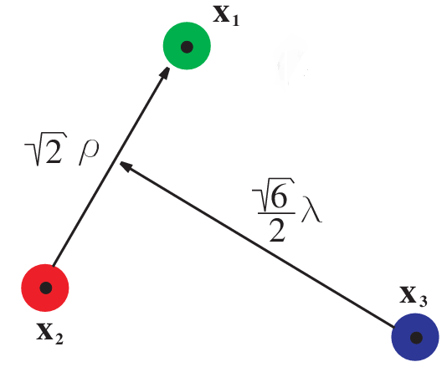
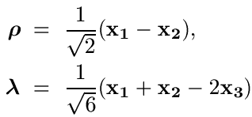


Center-of-mass system
Jacobi coordinates:
Non-relativistic energy – SO(6) invariant:
In the case of different masses coordinates are more complicated

Slide 5



Hyper-spherical coordinates
Triangle shape-space parameters:
Plus angles that fix the position/orientation of the triangle plane (some Φ₁, Φ₂, Φ₃ )
Smith-Iwai
Choice of angles

Slide 6
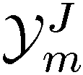

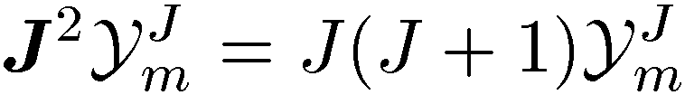
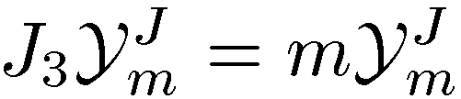
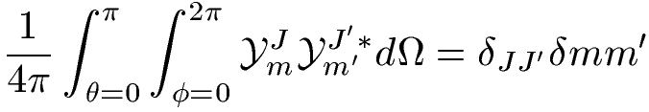

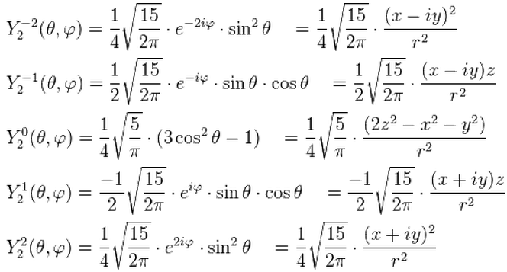
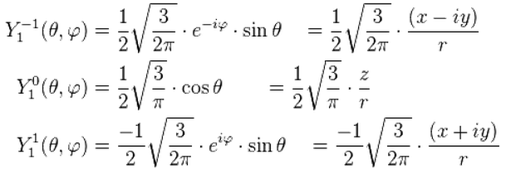
6 dim spherical harmonics = ???
Let us recall a few facts about standard 3D s.h.
Functions on sphere:
Orthogonal:
E.g.:
UIR of
UIR of

Slide 7
D-dim hyper-spherical harmonics
Intuitively: natural basis for functions on D-dim sphere
Functions on SO(D)/SO(D-1) – transform as traceless symmetric tensor representations (only a subset of all tensorial UIRs)
UIR labeled by single integer K, highest weight (K, 0, 0,…) <=> K boxes in a single row <=> K(K+D-2) quadratic Casimir eigenvalue
Homogenous harmonic polynomials (obeying Laplace eq. = traceless) of order K restricted to unit sphere
Harmonics of order K are further labeled by appropriate quantum numbers, usually related to SO(D) subgroups

Slide 8

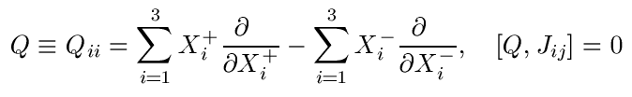

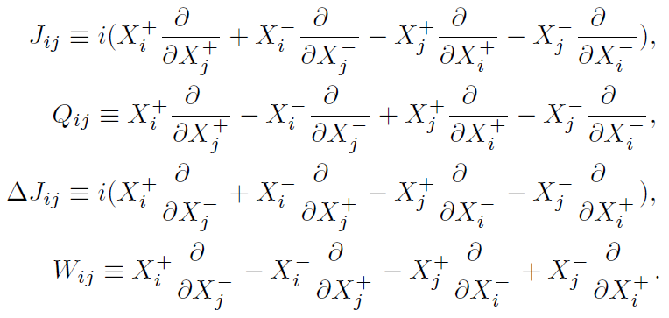
Decomposition
Complex Jacobi coord.:
Y-string potential = the shortest sum of string lengths ← function of triangle area
SO(3)
rotations
SO(6)
U(3)

Slide 9






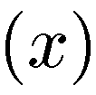

Quantum numbers
E.g. this can be
or often used operator
Labels of SO(6) hyper-spherical harmonics
U(1)
SO(6)
multiplicity
SU(3)
SO(3)  SO(2)

Slide 10





“Core polynomials”
Building blocks – two SO(3) vectors and
Start from polynomials sharp in Q:
Define “core polynomials” sharp in J, m and Q:
Core polynomial certainly contains component with
but also lower K components

Slide 11




“Harmonizing” polynomials
Let be shortened notation for all core polynomials with K values less than some given
Harmonic polynomials are obtained as ortho-complement w.r.t. polynomials with lesser K, i.e.:
where are deduced from requirement:
Scalar product of core polynomials

Slide 12
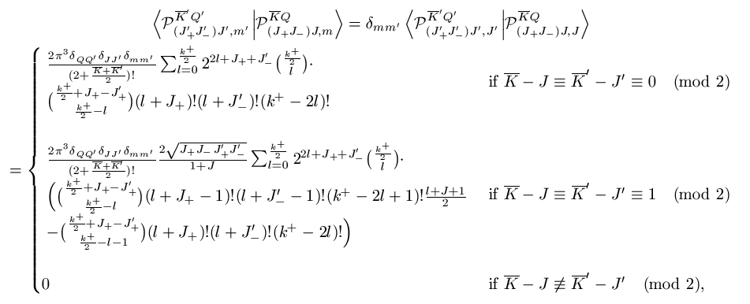


Scalar product of polynomials on hyper-sphere
Defined as
it can be shown that:
that for core polynomials eventually leads to a closed-form expression…
Integral of any number of polynomials can be evaluated (e.g. matrix elements)

Slide 13






Multiplicity
E.g. this can be
or often used operator
Exist nonorthogonal and
Degenerated subspace:
We remove multiplicity by using physically appropriate operator and obtain orthonormalized spherical harmonic polynomials as:
where and U is a matrix such that:

Slide 14

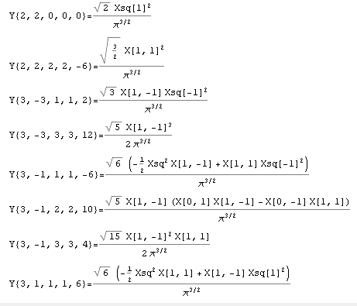
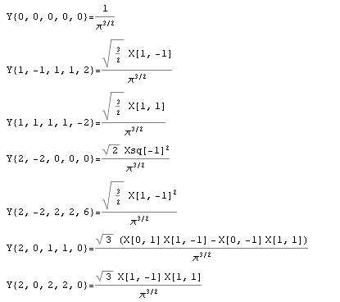
Now we can…
…explicitly calculate harmonics in Wolfram Mathematica…
…

Slide 15
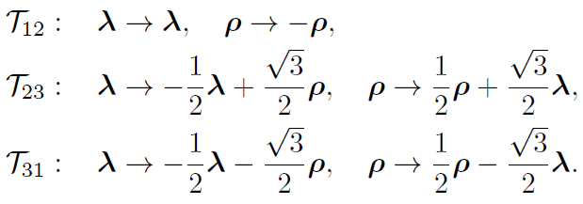
Particle permutations
Transformations are easily inferred since:

Slide 16


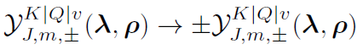
…leading to definite transformation properties of h.s. harmonics:
1) Transposition is pure sign:
2)
3)

Slide 17


Now we solve problems by h.s.h. decomposition
Schrodinger equation – coupled d.e. in : :
where:
In the first order p.t. this can be diagonalized into:

Slide 18

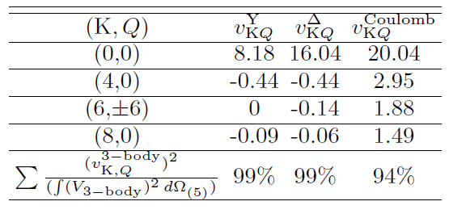
Realistic symmetric potentials effectively have only few harmonics!
So that energy and ordering of the states depend only on a few coefficients.

Slide 19
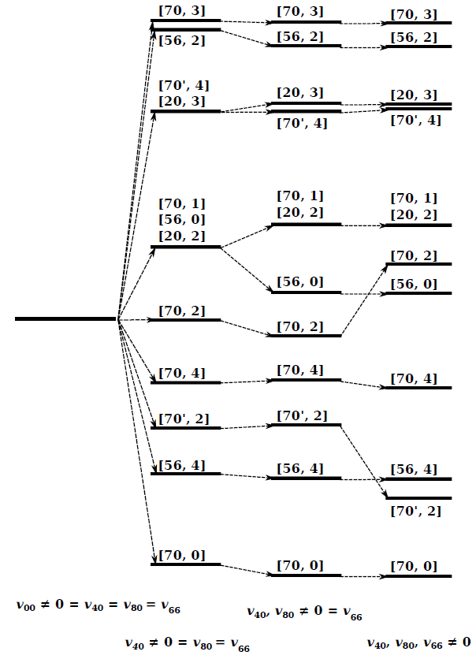
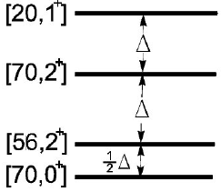
State orderings
Delta potential state ordering for K=4:
Fixed state ordering for K=2:

Slide 20
Thank you

Slide 21





Hyper-spherical coordinates
Triangle shape-space parameters:
Plus angles that fix the position/orientation of the triangle plane (some Φ₁, Φ₂, Φ₃ )
Smith-Iwai
Choice of angles

Slide 22
I - Case of planar motion
4 c.m. degrees of freedom - Jacobi coordinates:
or spherically R, α, φ and Φ
Hyper-angular momenta – so(4) algebra:
conjugated to overall angular momentum

Slide 23


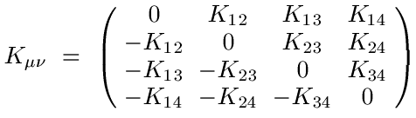



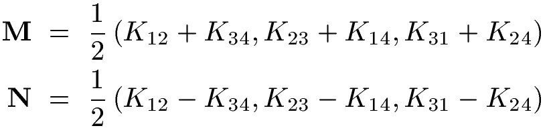
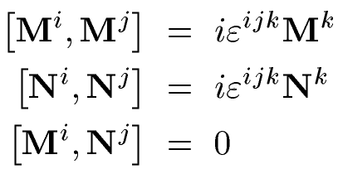
Decomposition:
= Q
Y-string potential = the shortest sum of string lengths ← function of triangle area

Slide 24




Hyper-spherical harmonics
Labeled by K, L and Q:
Functions coincide with SO(3) Wigner D-functions:
Interactions preserve value of L (rotational invariance) and some even preserve Q (area dependant like the Y-string three-quark potential)

Slide 25

Calculations now become much simpler…
We decompose potential energy into hyper-spherical harmonics and split the problem into radial and angular parts:

Slide 26
II - Case of 3D motion
6 c.m. degrees of freedom - Jacobi coordinates:
or spherically R, α, φ and some Φ₁, Φ₂, Φ₃
Hyper-angular momenta – so(6) algebra:
Tricky!

Slide 27




Particle permutations
Transformations are easily inferred since:
…

Slide 28
Goal in 3-particle case
Use c.m. system and split the problem into radial and angular parts
Interaction is not radial-only, but in all realistic interaction potentials “radial” component is dominant – starting point for perturbation approach
Solve angular part by decomposition to (hyper)spherical harmonics
Account for some special dynamical symmetries (e.g. Y-string three-quark potential)
Harmonics provide manifest permutation and rotation properties
Applications: three quark systems, molecular physics, atomic physics (helium atom), positronium ion…

